Slide 1

World Airline Route Search CSCE 3110 Data Structures Project

Slide 2
Implementing Graph

Slide 3
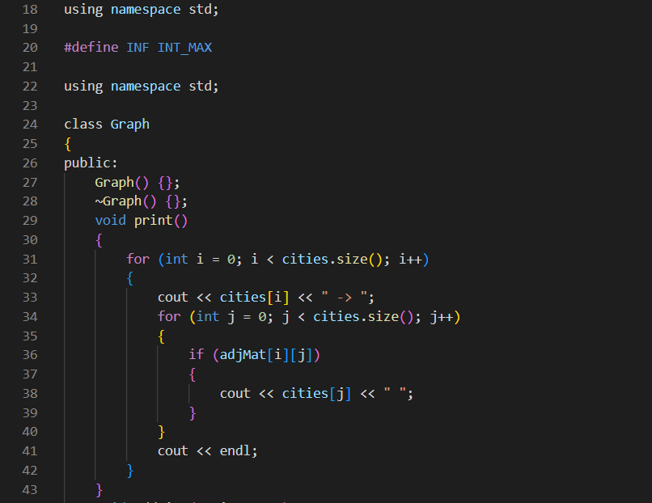

Slide 4
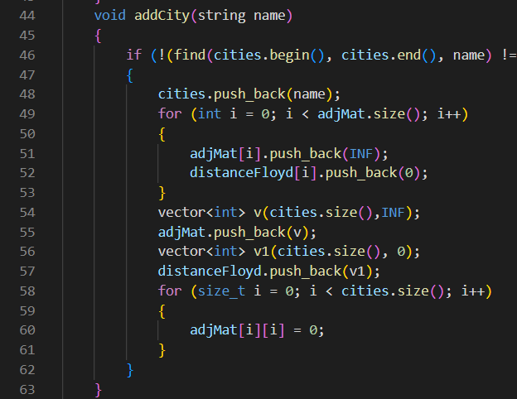

Slide 5
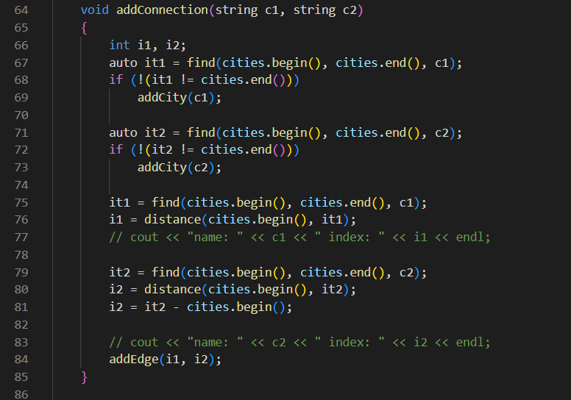

Slide 6
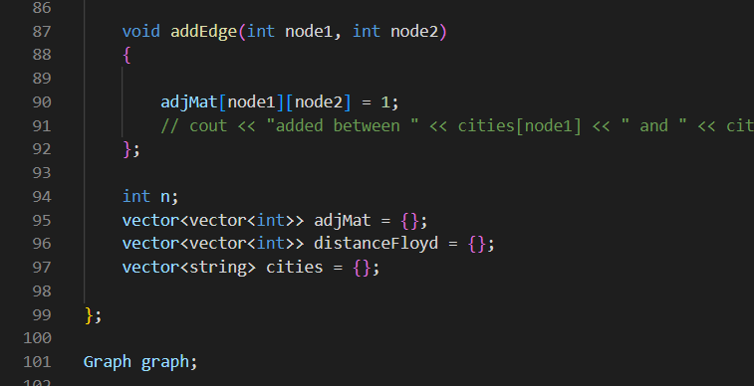

Slide 7
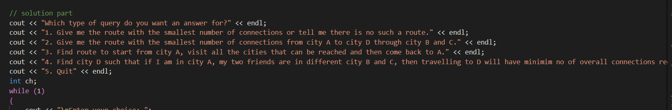
How The code starts:

Slide 8
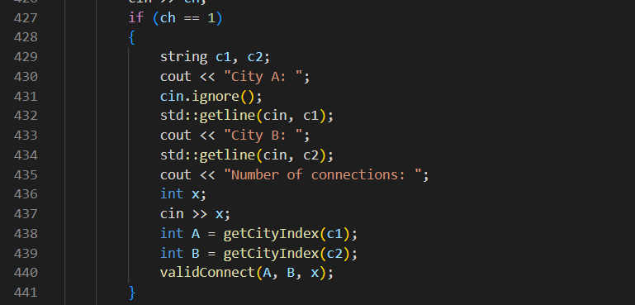

Slide 9
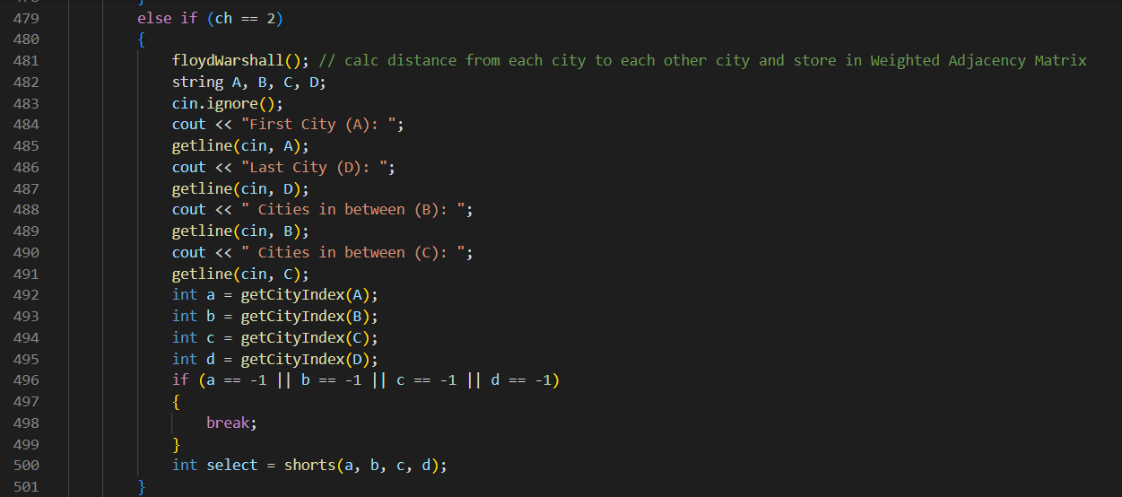

Slide 10
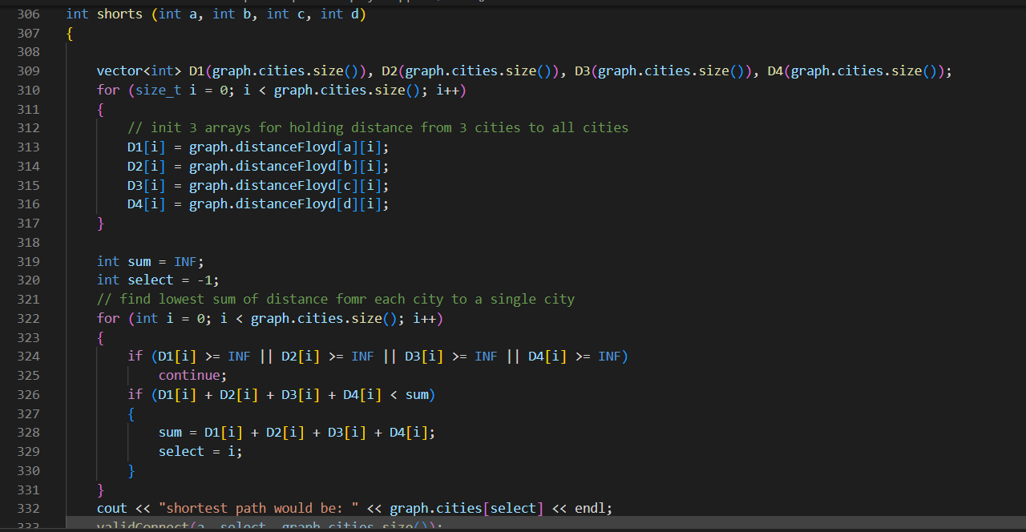

Slide 11
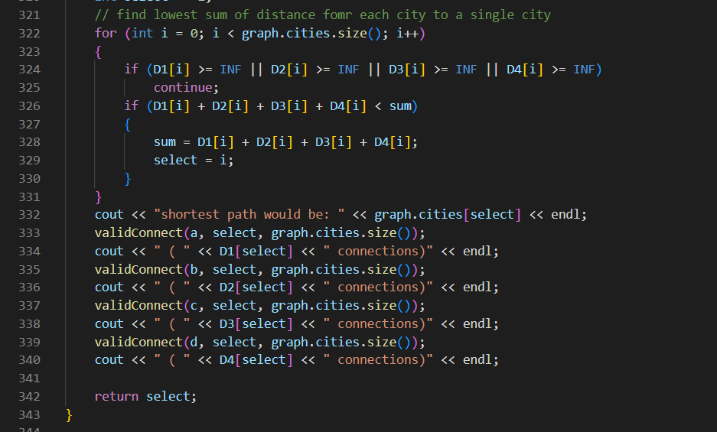

Slide 12
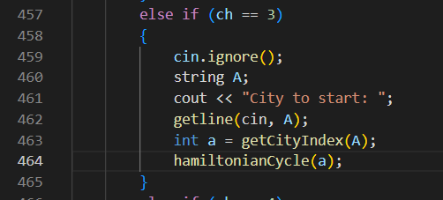

Slide 13
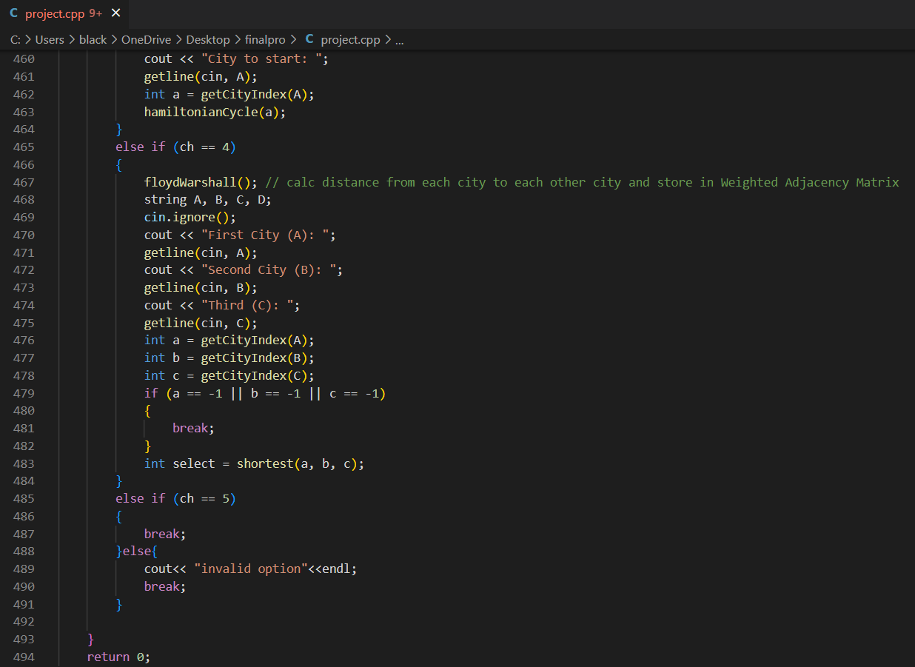

Slide 14
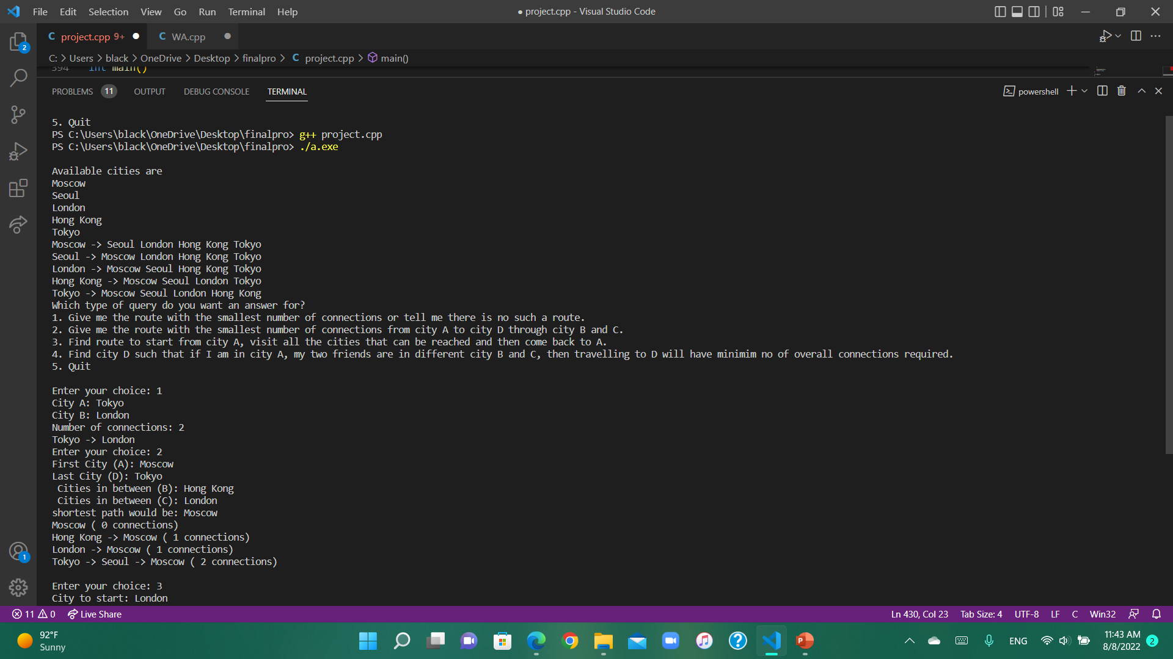

Slide 15
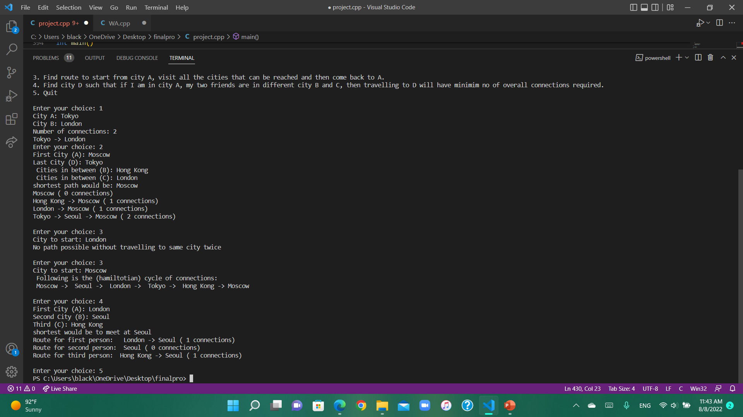

Slide 16
Main algorithms used
1- Floyd Warshall Algorithms
2- Hamiltonian Cycle

Slide 17
Floyd Warshall
Main idea:
To decrease the distance d(s, t) between two vertices s and t
we can try to add some intermediate vertices in the path s→t
We used this algorithm for parts 2 and 4

Slide 18
Hamiltonian Cycle
Hamiltonian Path such that there is an edge (in graph) from the last vertex to the first vertex of the Hamiltonian Path.

Slide 19
Why these algorithms?
1-As a result of the Floyd Warshall Algorithm, it will generate a matrix, which will represent the minimum distance from any node to all other nodes in the graph. At first, the output matrix is the same as the given cost matrix of the graph. After that, the output matrix will be updated with all vertices k as the intermediate vertex.
The time complexity of this algorithm is O(V^3), where V is the number of vertices in the graph.
The Hamiltonian cycle helps in time scheduling and the choice of travel routes and network topology
Time complexity of the above algorithm is O((2n^)*(n^2)). Depth-first search and backtracking can also help to check whether a Hamiltonian path exists in a graph or not.

Slide 20

Issues in the code

